Slide 1
1
Eyedrone

Slide 2
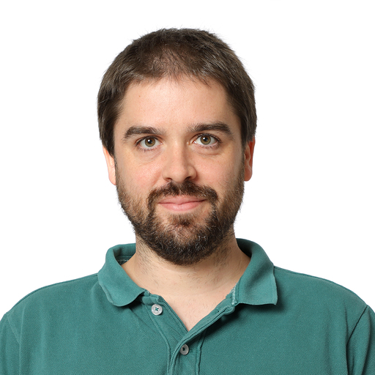
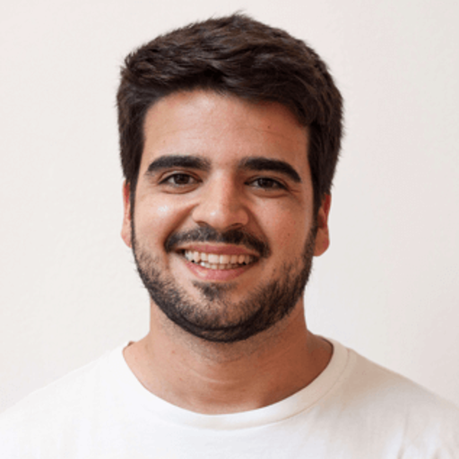
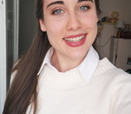

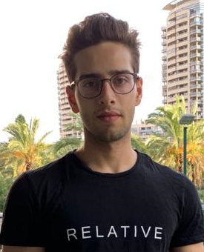
TEAM
2
Antonio
Eva
Albert
Asma
Ali

Slide 3
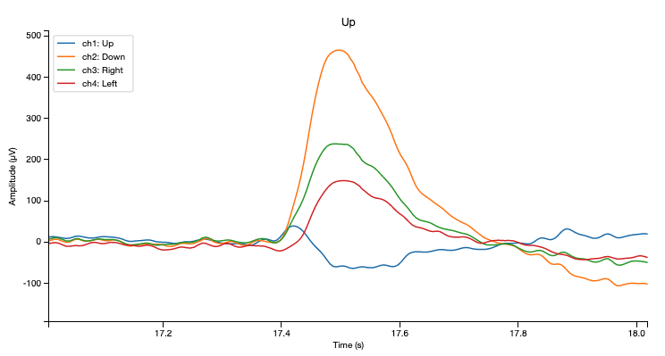
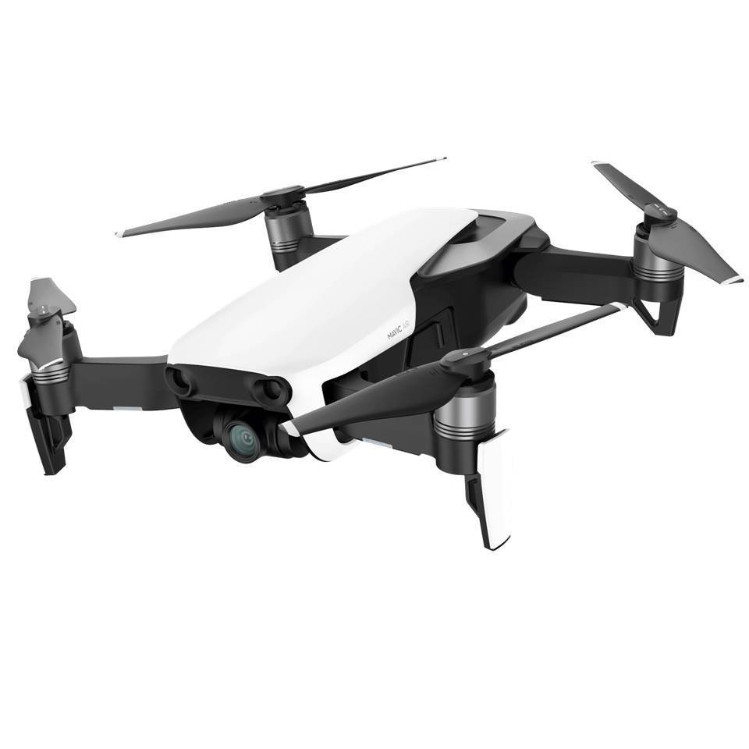
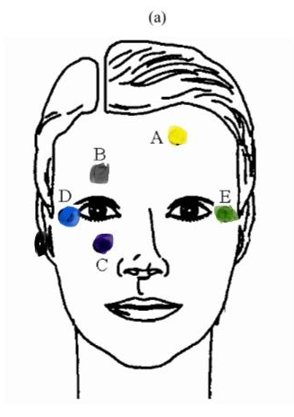
3
Move a drone using your eyes

Slide 4
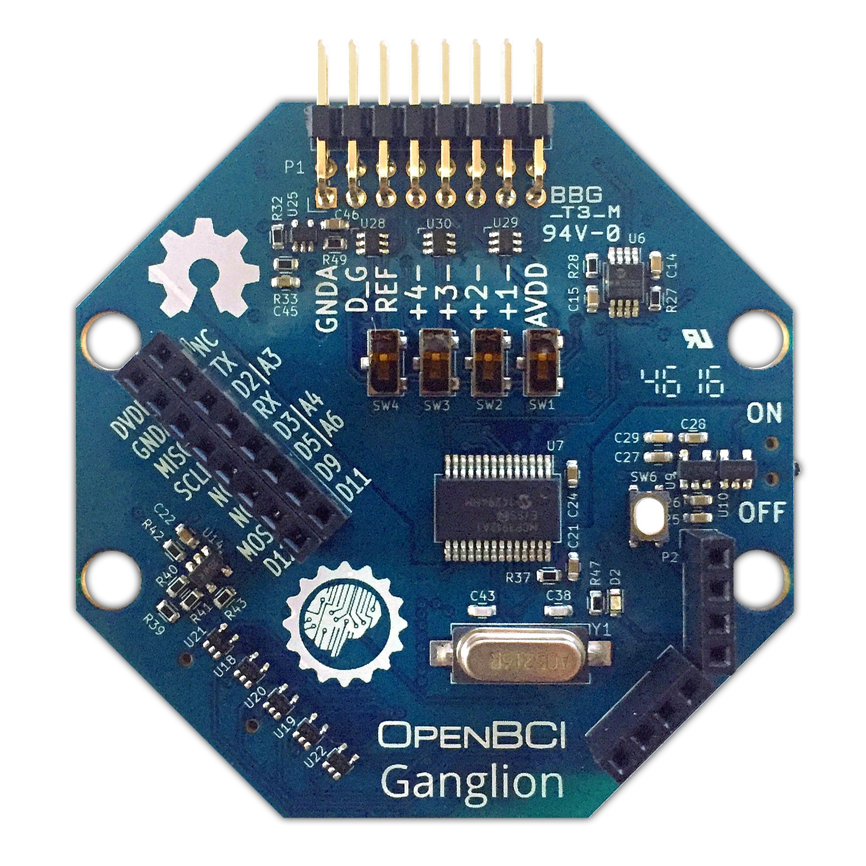
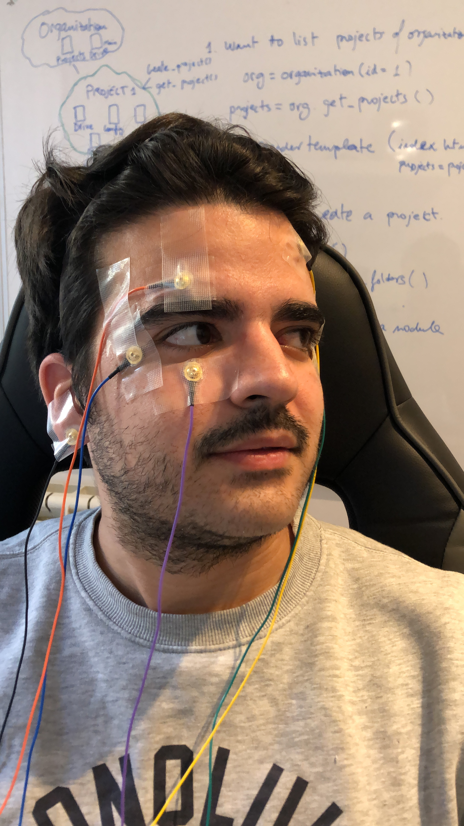
4
How?

Slide 5
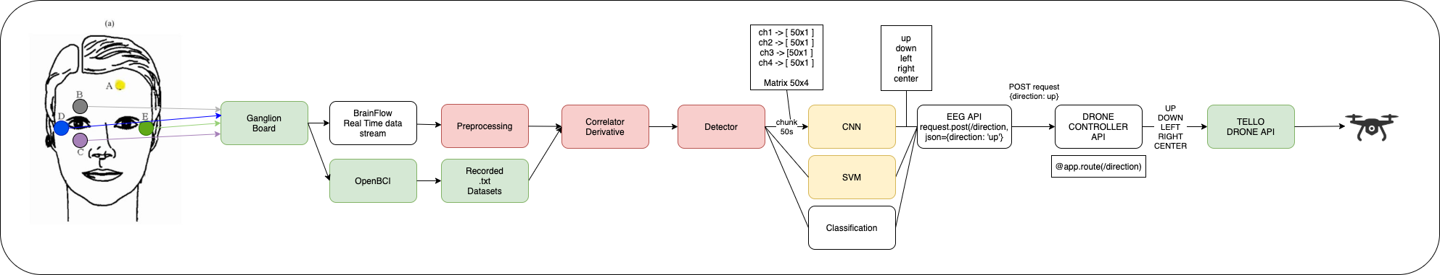
The end-to-end system
1. Data acquisition, preprocessing and detection
- Get raw data from sensors
- Process in real time
- When a change is detected, send a chunk of data as input to the neural network
2. Classification using AI
- Get movement of the eye as output
3. Drone controller
- Send movement to Drone
- Drone executes the movement
Microservices approach: parts are interchangeable. Example: instead of using eye movements, we could use brain "thoughts", just by changing the first part

Slide 6
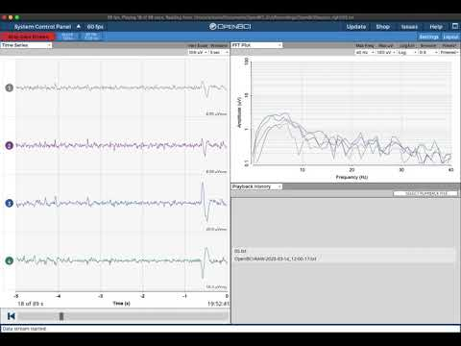
Ganglion Board + Sensors + Open BCI GUI Recording datasets
Usage of Ganglion Board (4-channel EEG) + golden cup sensors.
Recordings made with OpenBCI GUI
Recording example
right eye movement​

Slide 7
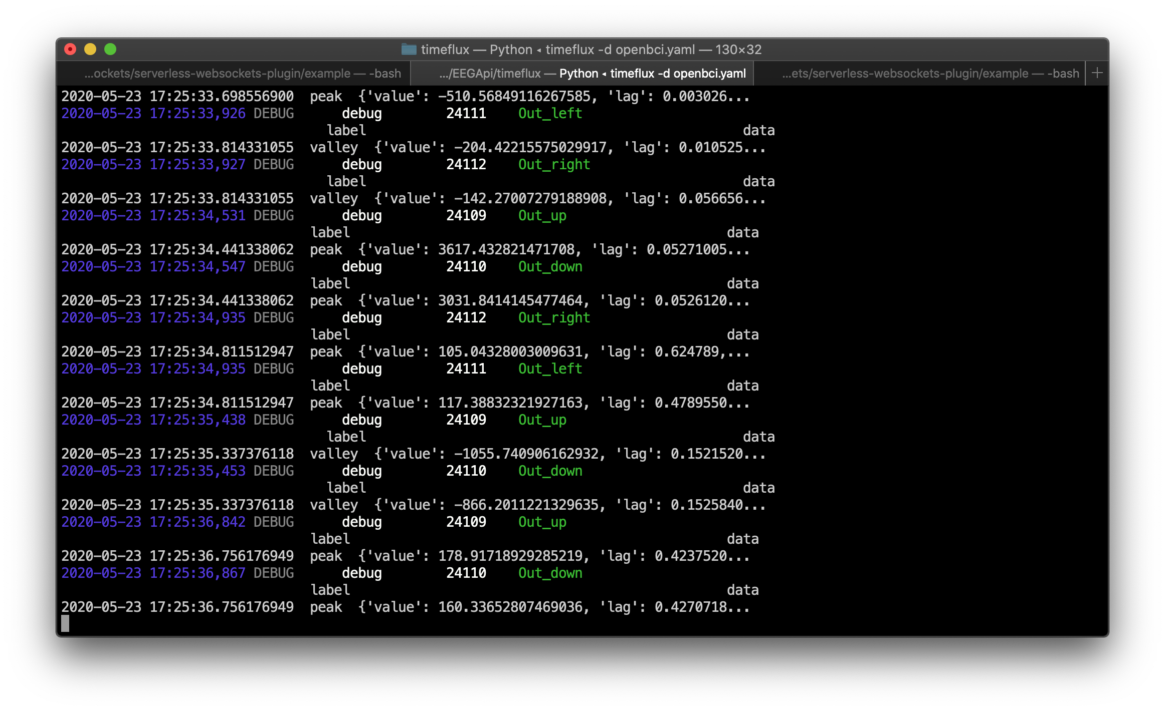
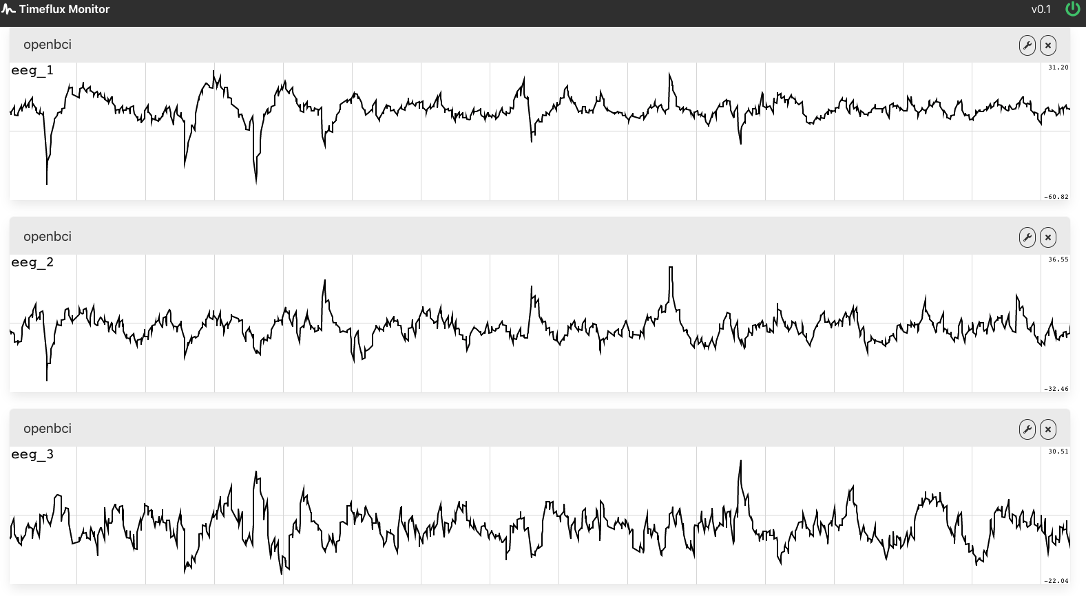
Ganglion Board + Brainflow + Timeflux
Raw data acquisition directly from board for real –time detection

Slide 8

Unfortunately, there are some parts missing:
What is missing? Real Time processing.
Get chunks of data in real time when an event happens (not only the event) and pass this as an input to the Neural Net. Making this work in real-time was not an easy work.
Pass the output of the neural net to the Drone API in real time.
Investigate REST vs Websockets to connect with the drone.

Slide 9
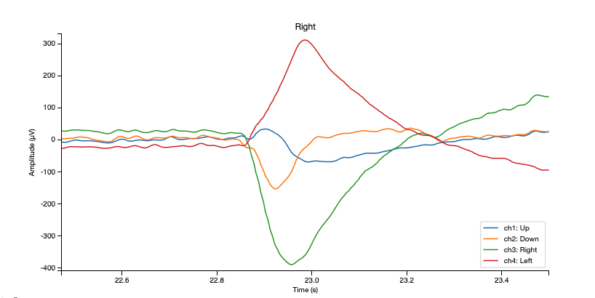
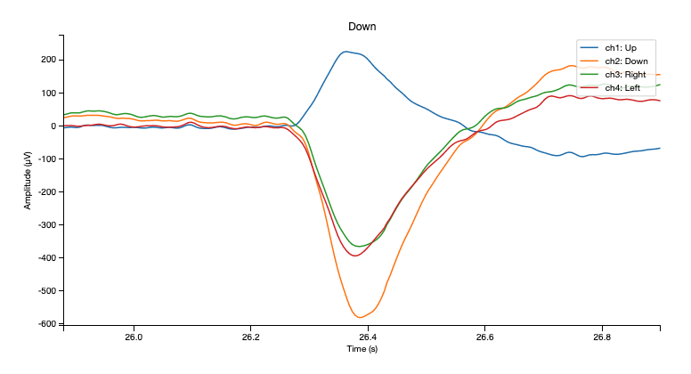
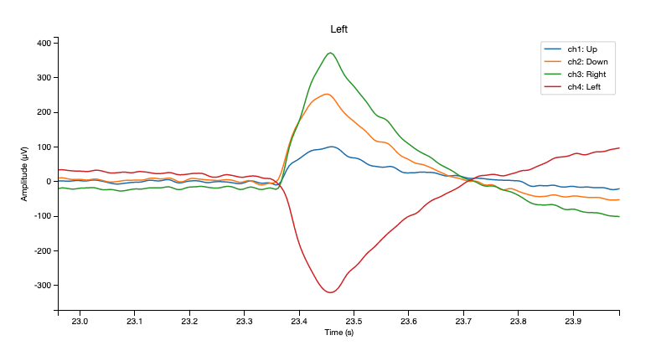
Dataset

Slide 10
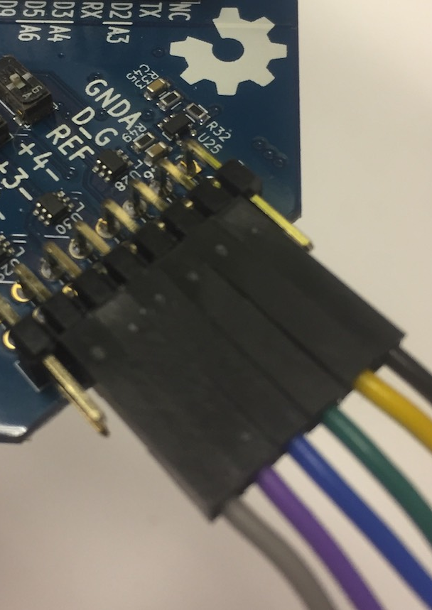
Dataset creation
Tests done: 25x Center --> Up --> Center movement 25x Center --> Down --> Center movements 25x Center --> Left --> Center movements 50x Center --> Right --> Center movements 1x Long Blinking Test
Using OpenBCI Ganglion Board (4-channels)

Slide 11

Main problems...
We wanted to:
-Have multiple sources of data
-From each have multiple recordings
-Do data augmentation
Lack of data

Slide 12
Learning
01
Data Augmentation
02
Machine Learning
03
Deep Learning

Slide 13
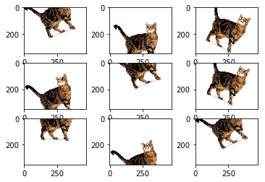
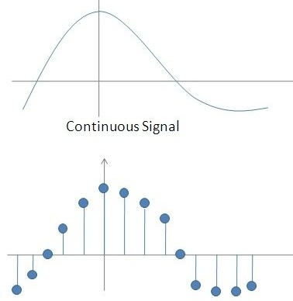
Data Augmentation
Concept:
Choose randomly P% of time points;
Stretch them with[Min-Max]s
Helps:
Less biased model;
Generated Noise;
Concept:
Choose randomly P% of time points;
Stretch them with[Min-Max]s
Helps:
Less biased model;
Generated Noise;

Slide 14
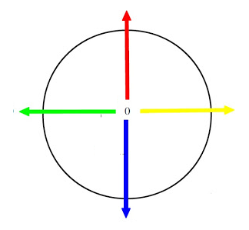
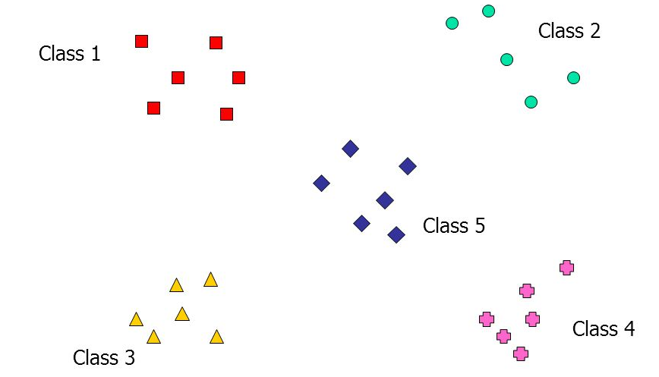
Machine Learning: SVM
UP
LEFT
CENTER
RIGHT
DOWN
Feature Vector:
Mean, Max , Min , Var;
5 classes
Result:
43% accuracy

Slide 15
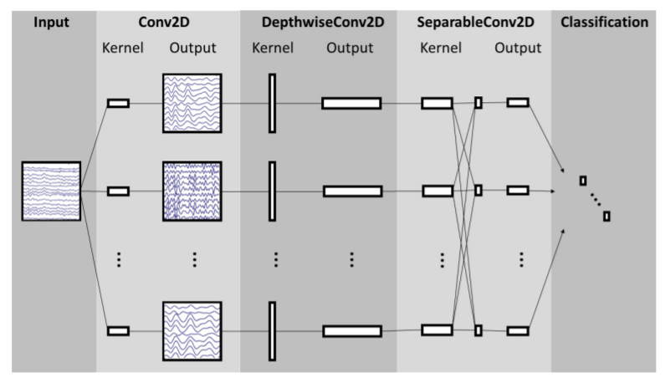
Deep Learning: EEGNet
EEGNet: A Compact Convolutional Neural Network for EEG-based Brain-Computer Interfaces Vernon J. Lawhern1, Amelia J. Solon, Nicholas R. Waytowich, Stephen M. Gordon,Chou P. Hung, and Brent J. Lance
Fully supervised
Few data
Compact architecture
Engineering

Slide 16
Deep Learning: EEGNet
Training and Engineering:
Number of channels 4
Frequency 100Hz
Result:
50,1% accuracy

Slide 17
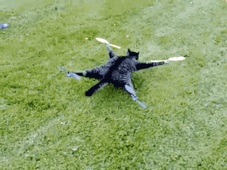
THE DRONE
Communications
DroneApp connected with the Drone API
Real time show
Flask app for simple navigation controller
Router port forwarding to be able to work remotely

Slide 18
5
Progress
Dataset creation: Collect EEG signal with 4 golden cup sensors
Done
Signal/data pre processing: Data cleaning, noise
Done
API Drone
01
02
03
04
05
Signal sending:
in real-time from a Board to PC and/or Cloud (Amazon Web Services)
Classification:
Data augmentaion Done
SVM Done
Deep learning On-going

